Slide 1
ASSEMBLY LANGUAGE PROGRAMMING
8086 ARCHITECTURE
MEMORY MODEL
PROGRAMMING MODEL- ADDRESSING MODES
INSTRUCTION SET OF 8086

Slide 2
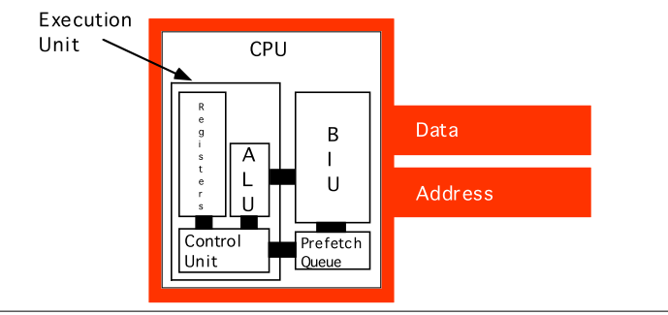

Slide 3
ADDRESSING MODES
Every instruction of a program has to operate on a data.
The different ways in which a source operand is denoted in an instruction are known as addressing modes.

Slide 4
ADDRESSING MODES
8086 Microprocessor
Register Addressing
Immediate Addressing
Direct Addressing
Register Indirect Addressing
Based Addressing
Indexed Addressing
Based Index Addressing
String Addressing
Direct I/O port Addressing
10. Indirect I/O port Addressing
11. Relative Addressing
12. Implied Addressing
Group I : Addressing modes for register and immediate data
Group II : Addressing modes for memory data
Group III : Addressing modes for I/O ports
Group IV : Relative Addressing mode
Group V : Implied Addressing mode

Slide 5
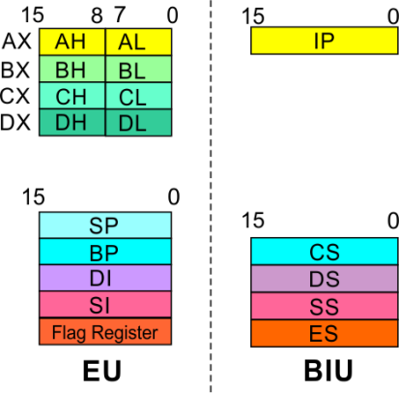
ADDRESSING MODES
8086 Microprocessor
Group I : Addressing modes for register and immediate data
Register Addressing
Immediate Addressing
Direct Addressing
Register Indirect Addressing
Based Addressing
Indexed Addressing
Based Index Addressing
String Addressing
Direct I/O port Addressing
10. Indirect I/O port Addressing
11. Relative Addressing
12. Implied Addressing
The instruction will specify the name of the register which holds the data to be operated by the instruction.
Example:
MOV CL, DH
The content of 8-bit register DH is moved to another 8-bit register CL
(CL) ← (DH)

Slide 6

8086 Microprocessor
Group I : Addressing modes for register and immediate data
In immediate addressing mode, an 8-bit or 16-bit data is specified as part of the instruction
Example:
MOV DL, 08H
The 8-bit data (08_{H}) given in the instruction is moved to DL
(DL) ← 08_{H}
MOV AX, 0A9FH
The 16-bit data (0A9F_{H}) given in the instruction is moved to AX register
(AX) ← 0A9F_{H}
Register Addressing
Immediate Addressing
Direct Addressing
Register Indirect Addressing
Based Addressing
Indexed Addressing
Based Index Addressing
String Addressing
Direct I/O port Addressing
10. Indirect I/O port Addressing
11. Relative Addressing
12. Implied Addressing

Slide 7
ADDRESSING MODES : MEMORY ACCESS
8086 Microprocessor
Offset Value (16 bits)
Segment Register (16 bits)
0 0 0 0
Adder
Physical Address (20 Bits)

Slide 8
ADDRESSING MODES : MEMORY ACCESS
8086 Microprocessor
20 Address lines ⇒ 8086 can address up to 2²⁰ = 1M bytes of memory
However, the largest register is only 16 bits
Physical Address will have to be calculated Physical Address : Actual address of a byte in memory. i.e. the value which goes out onto the address bus.
Memory Address represented in the form – Seg : Offset (Eg - 89AB:F012)
Each time the processor wants to access memory, it takes the contents of a segment register, shifts it one hexadecimal place to the left (same as multiplying by 16₁₀), then add the required offset to form the 20- bit address
16 bytes of contiguous memory

Slide 9
ADDRESSING MODES : MEMORY ACCESS
8086 Microprocessor
To access memory we use these four registers: BX, SI, DI, BP
Combining these registers inside [ ] symbols, we can get different memory locations (Effective Address, EA)
Supported combinations:
[BX + SI] [BX + DI] [BP + SI] [BP + DI] | [SI] [DI] d16 (variable offset only) [BX] | [BX + SI + d8] [BX + DI + d8] [BP + SI + d8] [BP + DI + d8]
[SI + d8] [DI + d8] [BP + d8] [BX + d8] | [BX + SI + d16] [BX + DI + d16] [BP + SI + d16] [BP + DI + d16] | [SI + d16] [DI + d16] [BP + d16] [BX + d16]
BX BP | SI DI | + disp

Slide 10
ADDRESSING MODES
8086 Microprocessor
Group II : Addressing modes for memory data
Register Addressing
Immediate Addressing
Direct Addressing
Register Indirect Addressing
Based Addressing
Indexed Addressing
Based Index Addressing
String Addressing
Direct I/O port Addressing
10. Indirect I/O port Addressing
11. Relative Addressing
12. Implied Addressing
Here, the effective address of the memory location at which the data operand is stored is given in the instruction.
The effective address is just a 16-bit number written directly in the instruction.
Example:
MOV BX, [1354H]
MOV BL, [0400H]
The square brackets around the 1354_{H} denotes the contents of the memory location. When executed, this instruction will copy the contents of the memory location into BX register.
This addressing mode is called direct because the displacement of the operand from the segment base is specified directly in the instruction.

Slide 11
ADDRESSING MODES
8086 Microprocessor
Group II : Addressing modes for memory data
Register Addressing
Immediate Addressing
Direct Addressing
Register Indirect Addressing
Based Addressing
Indexed Addressing
Based Index Addressing
String Addressing
Direct I/O port Addressing
10. Indirect I/O port Addressing
11. Relative Addressing
12. Implied Addressing
In Register indirect addressing, name of the register which holds the effective address (EA) will be specified in the instruction.
Registers used to hold EA are any of the following registers:
BX, BP, DI and SI.
Content of the DS register is used for base address calculation.
Example:
MOV CX, [BX]
Operations:
    EA = (BX)
    BA = (DS) x 16₁₀
    MA = BA + EA
    (CX) ← (MA) or,
    (CL) ← (MA)
    (CH) ← (MA +1)
Note : Register/ memory enclosed in brackets refer to content of register/ memory

Slide 12
8086 Microprocessor
Group II : Addressing modes for memory data
Register Addressing
Immediate Addressing
Direct Addressing
Register Indirect Addressing
Based Addressing
Indexed Addressing
Based Index Addressing
String Addressing
Direct I/O port Addressing
10. Indirect I/O port Addressing
11. Relative Addressing
12. Implied Addressing
In Based Addressing, BX or BP is used to hold the base value for effective address and a signed 8-bit or unsigned 16-bit displacement will be specified in the instruction.
In case of 8-bit displacement, it is sign extended to 16-bit before adding to the base value.
When BX holds the base value of EA, 20-bit physical address is calculated from BX and DS.
When BP holds the base value of EA, BP and SS is used.
Example:
MOV AX, [BX + 08H]
Operations:
    0008_{H} ← 08_{H} (Sign extended)
    EA = (BX) + 0008_{H}
    BA = (DS) x 16₁₀
    MA = BA + EA
    (AX) ← (MA) or,
    (AL) ← (MA)
    (AH) ← (MA + 1)

Slide 13
8086 Microprocessor
Group II : Addressing modes for memory data
Register Addressing
Immediate Addressing
Direct Addressing
Register Indirect Addressing
Based Addressing
Indexed Addressing
Based Index Addressing
String Addressing
Direct I/O port Addressing
10. Indirect I/O port Addressing
11. Relative Addressing
12. Implied Addressing
SI or DI register is used to hold an index value for memory data and a signed 8-bit or unsigned 16-bit displacement will be specified in the instruction.
Displacement is added to the index value in SI or DI register to obtain the EA.
In case of 8-bit displacement, it is sign extended to 16-bit before adding to the base value.
Example:
MOV CX, [SI + 0A2H]
    Operations:
      FFA2_{H} ← A2_{H} (Sign extended)
      EA = (SI) + FFA2_{H}
      BA = (DS) x 16₁₀
      MA = BA + EA
      (CX) ← (MA) or,
      (CL) ← (MA)
      (CH) ← (MA + 1)

Slide 14
8086 Microprocessor
Group II : Addressing modes for memory data
Register Addressing
Immediate Addressing
Direct Addressing
Register Indirect Addressing
Based Addressing
Indexed Addressing
Based Index Addressing
String Addressing
Direct I/O port Addressing
10. Indirect I/O port Addressing
11. Relative Addressing
12. Implied Addressing
In Based Index Addressing, the effective address is computed from the sum of a base register (BX or BP), an index register (SI or DI) and a displacement.
Example:
MOV DX, [BX + SI + 0AH]
    Operations:
      000A_{H} ← 0A_{H} (Sign extended)
      EA = (BX) + (SI) + 000A_{H}
      BA = (DS) x 16₁₀
      MA = BA + EA
      (DX) ← (MA) or,
      (DL) ← (MA)
      (DH) ← (MA + 1)

Slide 15
8086 Microprocessor
Group II : Addressing modes for memory data
Register Addressing
Immediate Addressing
Direct Addressing
Register Indirect Addressing
Based Addressing
Indexed Addressing
Based Index Addressing
String Addressing
Direct I/O port Addressing
10. Indirect I/O port Addressing
11. Relative Addressing
12. Implied Addressing
Employed in string operations to operate on string data.
The effective address (EA) of source data is stored in SI register and the EA of destination is stored in DI register.
Segment register for calculating base address of
source data is DS and that of the destination data is ES
    Example: MOVS BYTE
Operations:
Calculation of source memory location:
EA = (SI) BA = (DS) x 16₁₀ MA = BA + EA
Calculation of destination memory location:
EA_{E} = (DI) BA_{E} = (ES) x 16₁₀ MA_{E} = BA_{E} + EA_{E}
(MAE) ← (MA)
If DF = 1, then (SI) ← (SI) – 1 and (DI) = (DI) - 1
If DF = 0, then (SI) ← (SI) +1 and (DI) = (DI) + 1
Note : Effective address of the Extra segment register

Slide 16
ADDRESSING MODES
8086 Microprocessor
Group IV : Relative Addressing mode
In this addressing mode, the effective address of a program instruction is specified relative to Instruction Pointer (IP) by an 8-bit signed displacement.
Example: JZ 0AH
Operations:
  000A_{H} ← 0A_{H} (sign extend)
  If ZF = 1, then
  EA = (IP) + 000A_{H}
  BA = (CS) x 16₁₀
  MA = BA + EA
  If ZF = 1, then the program control jumps to new address calculated above.
  If ZF = 0, then next instruction of the program is executed.
Register Addressing
Immediate Addressing
Direct Addressing
Register Indirect Addressing
Based Addressing
Indexed Addressing
Based Index Addressing
String Addressing
Direct I/O port Addressing
10. Indirect I/O port Addressing
11. Relative Addressing
12. Implied Addressing

Slide 17
8086 Microprocessor
Group IV : Implied Addressing mode
Instructions using this mode have no operands. The instruction itself will specify the data to be operated by the instruction.
Example: CLC
This clears the carry flag to zero.
Register Addressing
Immediate Addressing
Direct Addressing
Register Indirect Addressing
Based Addressing
Indexed Addressing
Based Index Addressing
String Addressing
Direct I/O port Addressing
10. Indirect I/O port Addressing
11. Relative Addressing
12. Implied Addressing

Slide 18
8086 Microprocessor
Group III : Addressing modes for I/O ports
Register Addressing
Immediate Addressing
Direct Addressing
Register Indirect Addressing
Based Addressing
Indexed Addressing
Based Index Addressing
String Addressing
Direct I/O port Addressing
10. Indirect I/O port Addressing
11. Relative Addressing
12. Implied Addressing
These addressing modes are used to access data from standard I/O mapped devices or ports.
In direct port addressing mode, an 8-bit port address is directly specified in the instruction.
    Example: IN AL, [09H]
Operations: PORT_{addr} = 09_{H}
(AL) ← (PORT)
Content of port with address 09_{H} is moved to AL register
In indirect port addressing mode, the instruction will specify the name of the register which holds the port address. In 8086, the 16-bit port address is stored in the DX register.
    Example: OUT [DX], AX
Operations: PORT_{addr} = (DX)
(PORT) ← (AX)
Content of AX is moved to port whose address is specified by DX register.

Slide 19
ASSEMBLY LANGUAGE
PROGRAMMING

Slide 20
Assemble, Link, Run Files
  .asm – source file
  .obj – machine language file
  .lst – list file
  - it lists all the Opcodes, Offset addresses, and errors that
  MASM detected
  .crf – cross-reference file
  - an alphabetical list of all symbols and labels used in the
  program as well as the program line numbers in which they
  are referenced
  .map – map file
  - to see the location and number of bytes used when there
  are many segments for code or data

Slide 21
Program Segments
A segment is an area of memory that includes up to 64K bytes
Begins on an address evenly divisible by 16
8088/86
  Range of 1MB of memory, it has 20 address pins (2²⁰ = 1 MB)
  Can handle 64KB of code, 64KB of data, 64KB of stack
A typical Assembly language program consist of three segments:
  Code segments
  Data segment
  Stack segment

Slide 22
Segments
  .CODE ; marks the beginning of the code segment
    - starts with PROC (procedures) directive
    - the PROC directive may have the option FAR or NEAR
    - ends by ENDP directives
  .STACK ; marks the beginning of the stack segment
  - .STACK 64 ;reserves 64B of memory for the stack
  .DATA ; marks the beginning of the data segment
  - .DATA1 DB 52H
  ; DB directive allocates memory in byte-size chunks

Slide 23
Full Segment Definition
  Simple segment definition – refers to newer definition
  Full segment definition – refers to older definition
  SEGMENT directive – indicate to the assembler the beginning of a segment
  END directive – indicate to the assembler the beginning of a segment
  Example:
  label SEGMENT [options]
  ; statements
  label ENDS

Slide 24
Model Definition
MODEL directive –selects the size of the memory model
  MODEL MEDIUM
    Data must fit into 64KB
    Code can exceed 64KB
  MODEL COMPACT
    Data can exceed 64KB
    Code cannot exceed 64KB
  MODEL LARGE
    Data can exceed 64KB (but no single set of data should exceed 64KB)
    Code can exceed 64KB
  MODEL HUGE
    Data can exceed 64KB (data items i.e. arrays can exceed 64KB)
    Code can exceed 64KB
  MODEL TINY
    Data must fit into 64KB
    Code must fit into 64KB
    Used with COM files

Slide 25
EXE vs. COM
COM files
  Smaller in size (max of 64KB)
  Does not have header block
EXE files
  Unlimited size
  Do have header block (512 bytes of memory, contains information such as size, address location in memory, stack address)

Slide 26
Program Segments…example
Define the addresses for the 8086 when it fetches the instructions (opcodes and operands) from the code segments.
Logical address:
  Consist of a CS (code segment) and an IP (instruction pointer)
  format is CS:IP
Offset address
  IP contains the offset address
Physical address
  generated by shifting the CS left one hex digit and then adding it to the IP
  the resulting 20-bit address is called the physical address

Slide 27
Program Segments
Data segment
Example:
Add 5 bytes of data: 25H, 12H, 15H, 1FH, 2BH
Not using data segment
  MOV AL,00H ;clear AL
  ADD AL,25H ;add 25H to AL
  ADD AL,12H
  ADD AL,15H
  ADD AL,1FH
  ADD AL,2BH

Slide 28
DECLARING VARIABLES IN AN ASSEMBLY LANGUAGE PROGRAM
mov ax, ds:[10h] ; Fetch value of I
mul ds:[12h] ; Multiply by J
mov ds:[10h], ax ; Save in I (ignore overflow)
mov ax, ds:[12h] ; Fetch J
mul ds:[12h] ; Compute J*J
add ds:[10h], ax ; Add I*J + J*J, store into I
mov ax, i
mul j
mov i, ax
mov ax, j
mul j
add i, ax

Slide 29
Declaring and Accessing Scalar Variables
  Data Types and Data Definition
Assembler data directives
  ORG (origin) – to indicate the beginning of the offset address
    example:
    ORG 0010H
  DB (define byte) – allocation of memory in byte-sized chunks
    example:
    DATA1 DB 25 ;decimal
        DATA2 DB 10001001B ;binary
        DATA3 DB 12H ;hex
        DATA4 DB ‘2591’ ;ASCII numbers
  DATA5 DB ? ;set aside a byte
  DATA6 DB ‘Hello’ ;ASCII characters
  DATA7 DB “O’ Hi” ;ASCII characters

Slide 30
Data Types and Data Definition
Assembler data directives
  DUP (duplicate) – to duplicate a given number of characters
    example:
    DATA1 DB 0FFH, 0FFH, 0FFH, 0FFH ;fill 4 bytes with FF
    Can be replaced with:
    DATA2 DB 4 DUP(0FFH) ;fill 4 bytes with FF
    DATA3 DB 30 DUP(?) ;set aside 30 bytes
    DATA4 DB 5 DUP (2 DUP (99)) ;fill 10 bytes with 99

Slide 31
Data Types and Data Definition
  DW (define word) – allocate memory 2 bytes (one word) at a time
    example:
    DATA1 DW 342 ;decimal
        DATA2 DW 01010001001B ;binary
        DATA3 DW 123FH ;hex
        DATA4 DW 9,6,0CH, 0111B,’Hi’ ;Data numbers
  DATA5 DW 8 DUP (?) ;set aside 8 words
  EQU (equate) – define a constant without occupying a memory location
    example:
    COUNT EQU 25
    ;COUNT can be used in many places in the program

Slide 32
Data Types and Data Definition
Assembler data directives
  DD (define doubleword) – allocate memory 4 bytes (2 words) at a time
    DATA1 DD 1023 ;decimal
        DATA2 DD 01010001001001110110B ;binary
        DATA3 DD 7A3D43F1H ;hex
        DATA4 DD 54H, 65432H,65533 ;Data numbers
  DQ (define quadwordequate) – allocate memory 8 bytes (4 words) at a time
    DATA1 DQ 6723F9H ;hex
    DATA2 DQ ‘Hi’ ;ASCII characters
    DATA3 DQ ? ;nothing

Slide 33
Data Types and Data Definition
Assembler data directives
  DT (define ten bytes) – allocates packed BCD numbers (used in multibyte addition of BCD numbers)
    example:
    DATA1 DT 123456789123 ;BCD
        DATA2 DT ? ;nothing
        DATA3 DT 76543d ;assembler will convert decimal number to hex and store it

Slide 34
i db ?
j dw ?
k db ?
  mov i, 0
  mov j, 245
  mov k, -5
  mov al, i
  mov j, al

Slide 35
INSTRUCTION SET

Slide 36
INSTRUCTION SET
8086 Microprocessor
8086 supports 6 types of instructions.
Data Transfer Instructions
Arithmetic Instructions
Logical Instructions
String manipulation Instructions
Process Control Instructions
Control Transfer Instructions

Slide 37
INSTRUCTION SET
8086 Microprocessor
1. Data Transfer Instructions
Instructions that are used to transfer data/ address in to registers, memory locations and I/O ports.
Generally involve two operands: Source operand and Destination operand of the same size.
Source: Register or a memory location or an immediate data
Destination : Register or a memory location.
The size should be a either a byte or a word.
A 8-bit data can only be moved to 8-bit register/ memory and a 16-bit data can be moved to 16-bit register/ memory.

Slide 38
8086 Microprocessor
1. Data Transfer Instructions
Mnemonic: MOV, XCHG, PUSH, POP, IN, OUT …
MOV reg2/ mem, reg1/ mem MOV reg2, reg1 MOV mem, reg1 MOV reg2, mem | (reg2) ← (reg1) (mem) ← (reg1) (reg2) ← (mem)
MOV reg/ mem, data MOV reg, data MOV mem, data | (reg) ← data (mem) ← data
XCHG reg2/ mem, reg1 XCHG reg2, reg1 XCHG mem, reg1 | (reg2) ↔ (reg1) (mem) ↔ (reg1)

Slide 39
8086 Microprocessor
1. Data Transfer Instructions
MOV, XCHG, PUSH, POP, IN, OUT …
PUSH reg16/ mem PUSH reg16 PUSH mem | (SP) ← (SP) – 2 MA _{S} = (SS) x 16₁₀ + SP (MA _{S} ; MA _{S} + 1) ← (reg16) (SP) ← (SP) – 2 MA _{S} = (SS) x 16₁₀ + SP (MA _{S} ; MA _{S} + 1) ← (mem)
POP reg16/ mem POP reg16 POP mem | MA _{S} = (SS) x 16₁₀ + SP (reg16) ← (MA _{S} ; MA _{S} + 1) (SP) ← (SP) + 2 MA _{S} = (SS) x 16₁₀ + SP (mem) ← (MA _{S} ; MA _{S} + 1) (SP) ← (SP) + 2

Slide 40
8086 Microprocessor
1. Data Transfer Instructions
MOV, XCHG, PUSH, POP, IN, OUT …
IN A, [DX] IN AL, [DX] IN AX, [DX] | PORT_{addr} = (DX) (AL) ← (PORT) PORT_{addr} = (DX) (AX) ← (PORT)
IN A, addr8 IN AL, addr8 IN AX, addr8 | (AL) ← (addr8) (AX) ← (addr8)
OUT [DX], A OUT [DX], AL OUT [DX], AX | PORT_{addr} = (DX) (PORT) ← (AL) PORT_{addr} = (DX) (PORT) ← (AX)
OUT addr8, A OUT addr8, AL OUT addr8, AX | (addr8) ← (AL) (addr8) ← (AX)

Slide 41
8086 Microprocessor
2. Arithmetic Instructions
ADD, ADC, SUB, SBB, INC, DEC, MUL, DIV, CMP…
ADD reg2/ mem, reg1/mem ADC reg2, reg1 ADC reg2, mem ADC mem, reg1 | (reg2) ← (reg1) + (reg2) (reg2) ← (reg2) + (mem) (mem) ← (mem)+(reg1)
ADD reg/mem, data ADD reg, data ADD mem, data | (reg) ← (reg)+ data (mem) ← (mem)+data
ADD A, data ADD AL, data8 ADD AX, data16 | (AL) ← (AL) + data8 (AX) ← (AX) +data16

Slide 42
8086 Microprocessor
2. Arithmetic Instructions
ADD, ADC, SUB, SBB, INC, DEC, MUL, DIV, CMP…
ADC reg2/ mem, reg1/mem ADC reg2, reg1 ADC reg2, mem ADC mem, reg1 | (reg2) ← (reg1) + (reg2)+CF (reg2) ← (reg2) + (mem)+CF (mem) ← (mem)+(reg1)+CF
ADC reg/mem, data ADC reg, data ADC mem, data | (reg) ← (reg)+ data+CF (mem) ← (mem)+data+CF
ADDC A, data ADD AL, data8 ADD AX, data16 | (AL) ← (AL) + data8+CF (AX) ← (AX) +data16+CF

Slide 43
8086 Microprocessor
2. Arithmetic Instructions
ADD, ADC, SUB, SBB, INC, DEC, MUL, DIV, CMP…
SUB reg2/ mem, reg1/mem SUB reg2, reg1 SUB reg2, mem SUB mem, reg1 | (reg2) ← (reg1) - (reg2) (reg2) ← (reg2) - (mem) (mem) ← (mem) - (reg1)
SUB reg/mem, data SUB reg, data SUB mem, data | (reg) ← (reg) - data (mem) ← (mem) - data
SUB A, data SUB AL, data8 SUB AX, data16 | (AL) ← (AL) - data8 (AX) ← (AX) - data16

Slide 44
8086 Microprocessor
2. Arithmetic Instructions
ADD, ADC, SUB, SBB, INC, DEC, MUL, DIV, CMP…
SBB reg2/ mem, reg1/mem SBB reg2, reg1 SBB reg2, mem SBB mem, reg1 | (reg2) ← (reg1) - (reg2) - CF (reg2) ← (reg2) - (mem)- CF (mem) ← (mem) - (reg1) –CF
SBB reg/mem, data SBB reg, data SBB mem, data | (reg) ← (reg) – data - CF (mem) ← (mem) - data - CF
SBB A, data SBB AL, data8 SBB AX, data16 | (AL) ← (AL) - data8 - CF (AX) ← (AX) - data16 - CF

Slide 45
8086 Microprocessor
2. Arithmetic Instructions
Mnemonics: ADD, ADC, SUB, SBB, INC, DEC, MUL, DIV, CMP…
INC reg/ mem INC reg8 INC reg16 INC mem | (reg8) ← (reg8) + 1 (reg16) ← (reg16) + 1 (mem) ← (mem) + 1
DEC reg/ mem DEC reg8 DEC reg16 DEC mem | (reg8) ← (reg8) - 1 (reg16) ← (reg16) - 1 (mem) ← (mem) - 1

Slide 46
8086 Microprocessor
2. Arithmetic Instructions
ADD, ADC, SUB, SBB, INC, DEC, MUL, DIV, CMP…
MUL reg/ mem MUL reg MUL mem | For byte : (AX) ← (AL) x (reg8) For word : (DX)(AX) ← (AX) x (reg16) For byte : (AX) ← (AL) x (mem8) For word : (DX)(AX) ← (AX) x (mem16)
IMUL reg/ mem IMUL reg IMUL mem | For byte : (AX) ← (AL) x (reg8) For word : (DX)(AX) ← (AX) x (reg16) For byte : (AX) ← (AX) x (mem8) For word : (DX)(AX) ← (AX) x (mem16)

Slide 47
8086 Microprocessor
2. Arithmetic Instructions
Mnemonics: ADD, ADC, SUB, SBB, INC, DEC, MUL, DIV, CMP…
DIV reg/ mem DIV reg DIV mem | For 16-bit :- 8-bit : (AL) ← (AX) :- (reg8) Quotient (AH) ← (AX) MOD(reg8) Remainder For 32-bit :- 16-bit : (AX) ← (DX)(AX) :- (reg16) Quotient (DX) ← (DX)(AX) MOD(reg16) Remainder For 16-bit :- 8-bit : (AL) ← (AX) :- (mem8) Quotient (AH) ← (AX) MOD(mem8) Remainder For 32-bit :- 16-bit : (AX) ← (DX)(AX) :- (mem16) Quotient (DX) ← (DX)(AX) MOD(mem16) Remainder

Slide 48
8086 Microprocessor
2. Arithmetic Instructions
Mnemonics: ADD, ADC, SUB, SBB, INC, DEC, MUL, DIV, CMP…
IDIV reg/ mem IDIV reg IDIV mem | For 16-bit :- 8-bit : (AL) ← (AX) :- (reg8) Quotient (AH) ← (AX) MOD(reg8) Remainder For 32-bit :- 16-bit : (AX) ← (DX)(AX) :- (reg16) Quotient (DX) ← (DX)(AX) MOD(reg16) Remainder For 16-bit :- 8-bit : (AL) ← (AX) :- (mem8) Quotient (AH) ← (AX) MOD(mem8) Remainder For 32-bit :- 16-bit : (AX) ← (DX)(AX) :- (mem16) Quotient (DX) ← (DX)(AX) MOD(mem16) Remainder

Slide 49
8086 Microprocessor
2. Arithmetic Instructions
Mnemonics: ADD, ADC, SUB, SBB, INC, DEC, MUL, DIV, CMP…
CMP reg2/mem, reg1/ mem CMP reg2, reg1 CMP reg2, mem CMP mem, reg1 | Modify flags ← (reg2) – (reg1) If (reg2) > (reg1) then CF=0, ZF=0, SF=0 If (reg2) < (reg1) then CF=1, ZF=0, SF=1 If (reg2) = (reg1) then CF=0, ZF=1, SF=0 Modify flags ← (reg2) – (mem) If (reg2) > (mem) then CF=0, ZF=0, SF=0 If (reg2) < (mem) then CF=1, ZF=0, SF=1 If (reg2) = (mem) then CF=0, ZF=1, SF=0 Modify flags ← (mem) – (reg1) If (mem) > (reg1) then CF=0, ZF=0, SF=0 If (mem) < (reg1) then CF=1, ZF=0, SF=1 If (mem) = (reg1) then CF=0, ZF=1, SF=0

Slide 50
8086 Microprocessor
2. Arithmetic Instructions
Mnemonics: ADD, ADC, SUB, SBB, INC, DEC, MUL, DIV, CMP…
CMP reg/mem, data CMP reg, data CMP mem, data | Modify flags ← (reg) – (data) If (reg) > data then CF=0, ZF=0, SF=0 If (reg) < data then CF=1, ZF=0, SF=1 If (reg) = data then CF=0, ZF=1, SF=0 Modify flags ← (mem) – (mem) If (mem) > data then CF=0, ZF=0, SF=0 If (mem) < data then CF=1, ZF=0, SF=1 If (mem) = data then CF=0, ZF=1, SF=0

Slide 51
8086 Microprocessor
2. Arithmetic Instructions
Mnemonics: ADD, ADC, SUB, SBB, INC, DEC, MUL, DIV, CMP…
CMP A, data CMP AL, data8 CMP AX, data16 | Modify flags ← (AL) – data8 If (AL) > data8 then CF=0, ZF=0, SF=0 If (AL) < data8 then CF=1, ZF=0, SF=1 If (AL) = data8 then CF=0, ZF=1, SF=0 Modify flags ← (AX) – data16 If (AX) > data16 then CF=0, ZF=0, SF=0 If (mem) < data16 then CF=1, ZF=0, SF=1 If (mem) = data16 then CF=0, ZF=1, SF=0

Slide 52
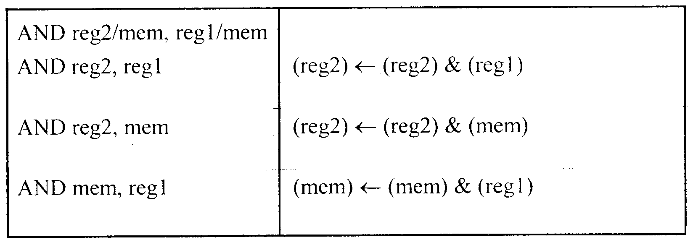
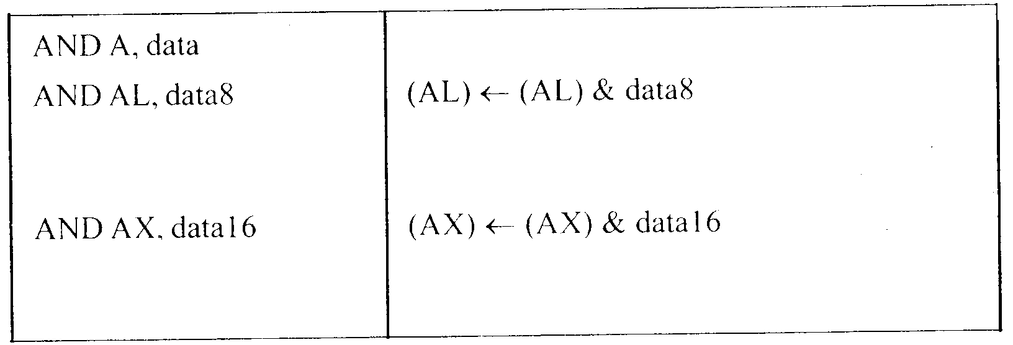
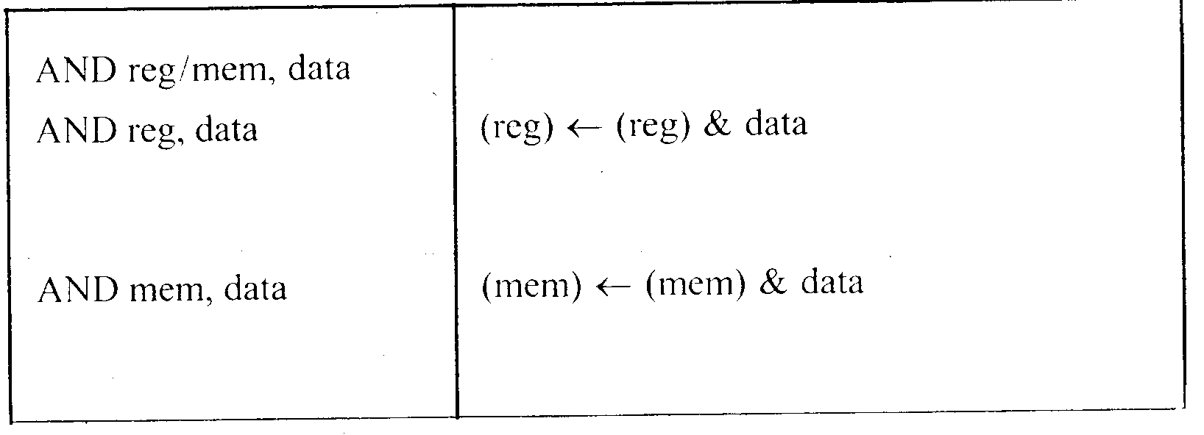
8086 Microprocessor
3. Logical Instructions
Mnemonics: AND, OR, XOR, TEST, SHR, SHL, RCR, RCL …

Slide 53
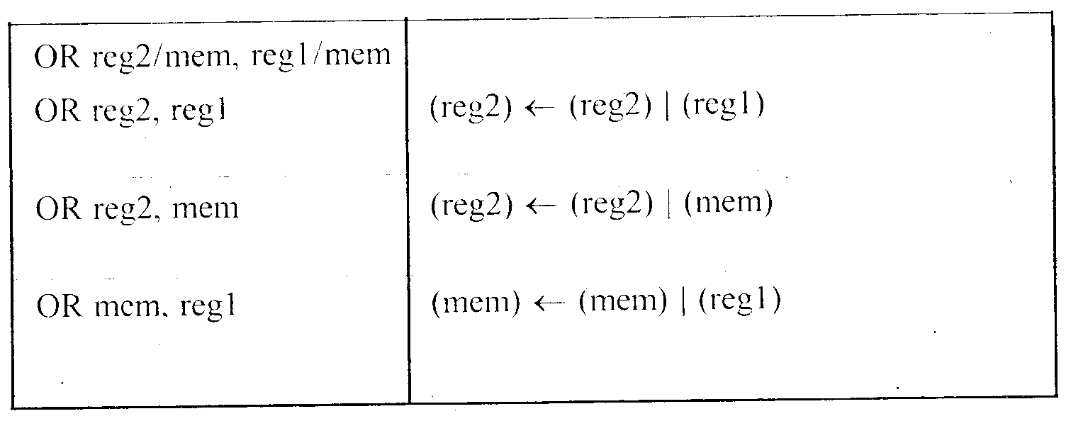
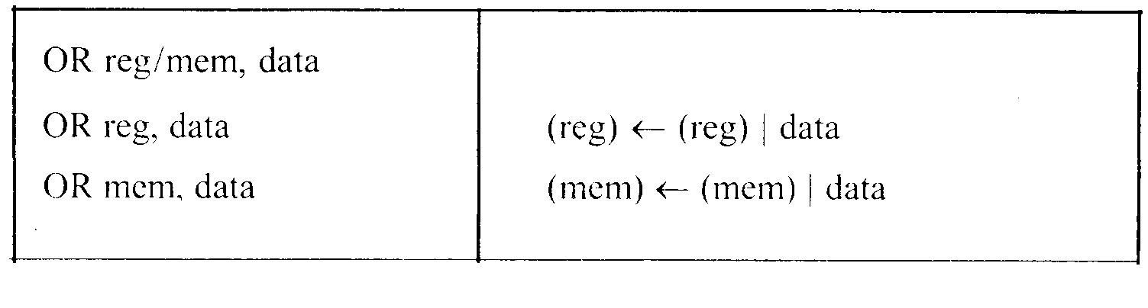
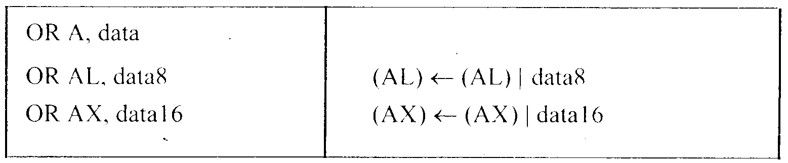
8086 Microprocessor
3. Logical Instructions
Mnemonics: AND, OR, XOR, TEST, SHR, SHL, RCR, RCL …

Slide 54
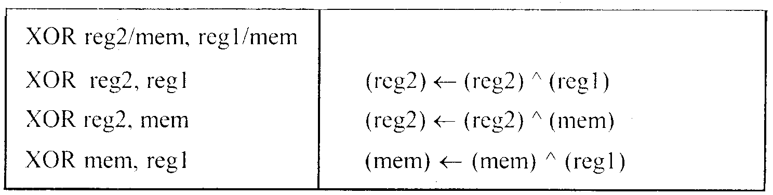
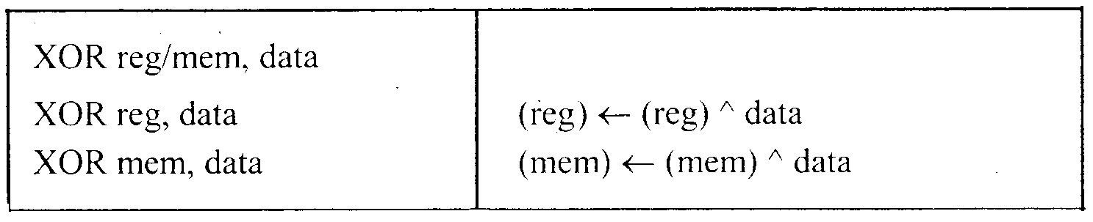
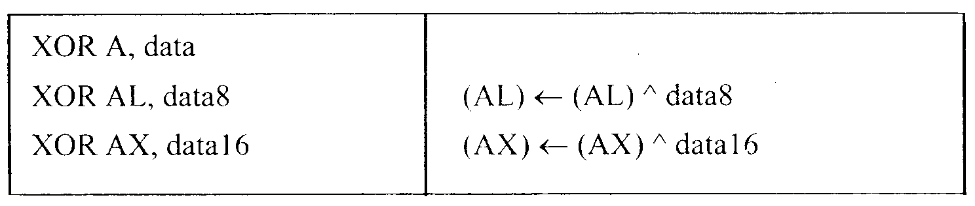
8086 Microprocessor
3. Logical Instructions
Mnemonics: AND, OR, XOR, TEST, SHR, SHL, RCR, RCL …

Slide 55
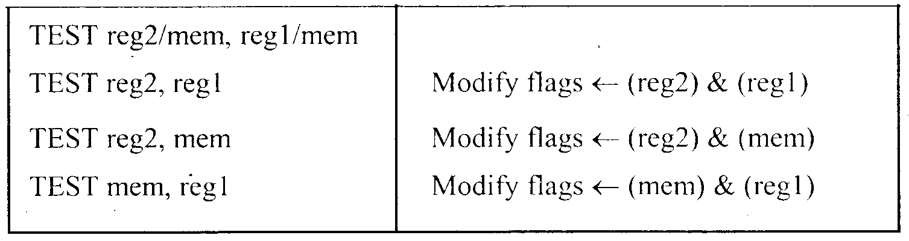
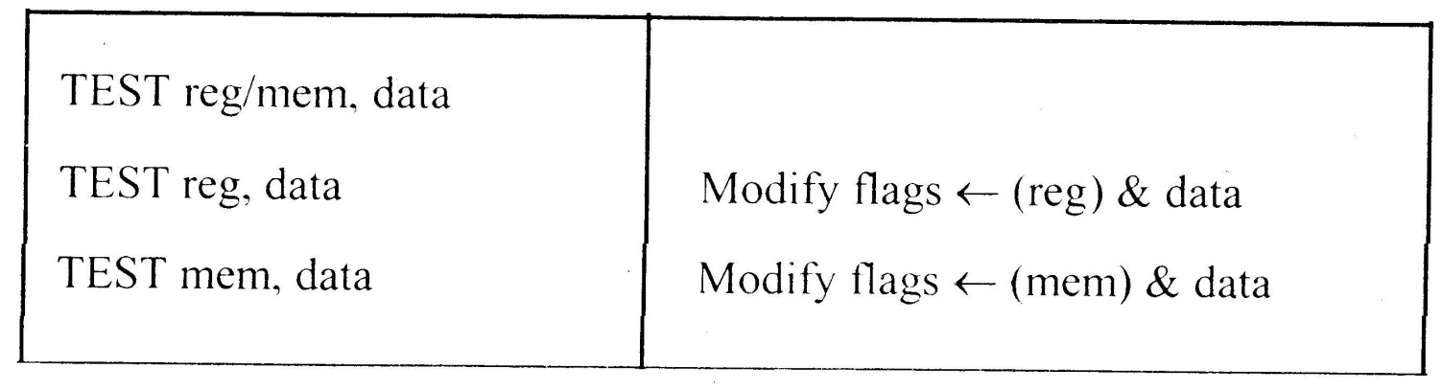
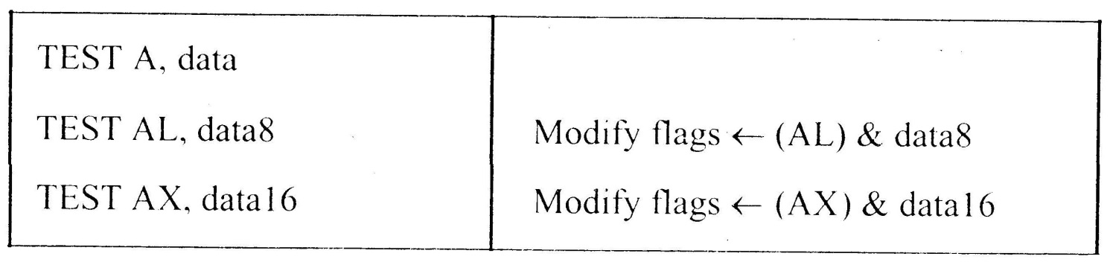
8086 Microprocessor
3. Logical Instructions
Mnemonics: AND, OR, XOR, TEST, SHR, SHL, RCR, RCL …

Slide 56
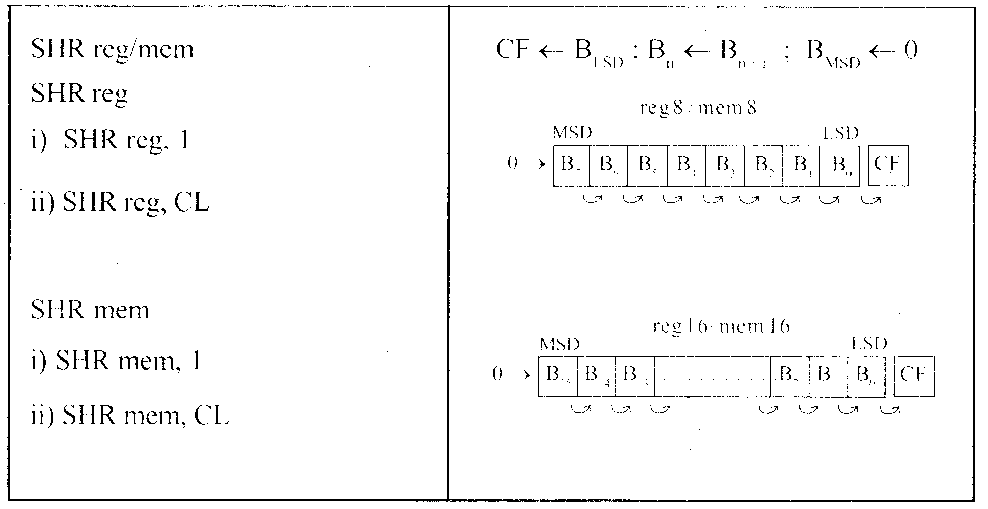
8086 Microprocessor
3. Logical Instructions
Mnemonics: AND, OR, XOR, TEST, SHR, SHL, RCR, RCL …

Slide 57
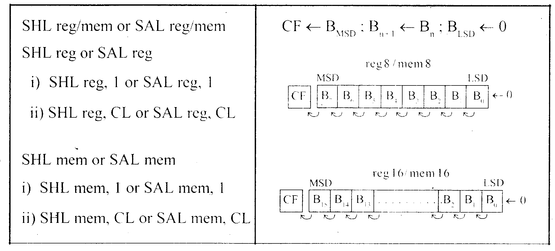
8086 Microprocessor
3. Logical Instructions
Mnemonics: AND, OR, XOR, TEST, SHR, SHL, RCR, RCL …

Slide 58
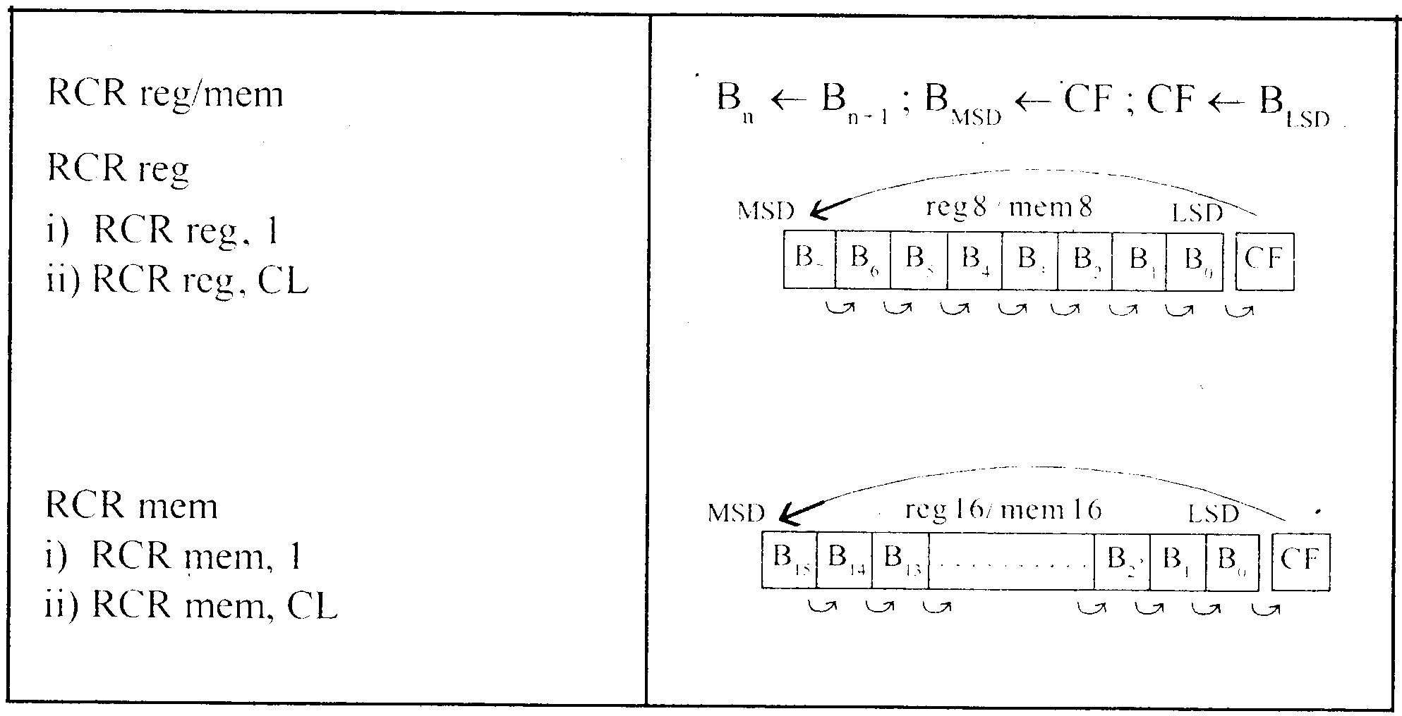
8086 Microprocessor
3. Logical Instructions
Mnemonics: AND, OR, XOR, TEST, SHR, SHL, RCR, RCL …

Slide 59
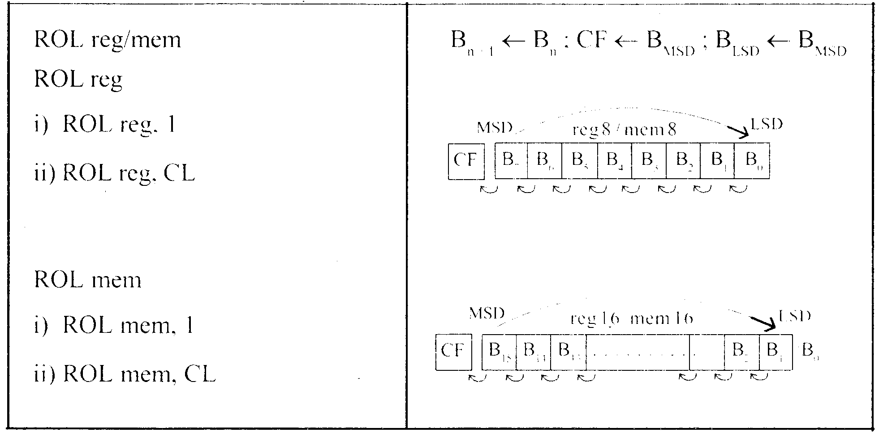
8086 Microprocessor
3. Logical Instructions
AND, OR, XOR, TEST, SHR, SHL, RCR, RCL …

Slide 60
String : Sequence of bytes or words
8086 instruction set includes instruction for string movement, comparison, scan, load and store.
REP instruction prefix : used to repeat execution of string instructions
String instructions end with S or SB or SW. S represents string, SB string byte and SW string word.
Offset or effective address of the source operand is stored in SI register and that of the destination operand is stored in DI register.
DF = 0 ⇒ SI and DI are incremented by 1 for byte and 2 for word.
DF = 1 ⇒ SI and DI are decremented by 1 for byte and 2 for word.
Depending on the status of DF, SI and DI registers are automatically updated.

Slide 61
8086 Microprocessor
4. String Manipulation Instructions
Mnemonics: REP, MOVS, CMPS, SCAS, LODS, STOS
REP REPZ/ REPE (Repeat CMPS or SCAS until ZF = 0) REPNZ/ REPNE (Repeat CMPS or SCAS until ZF = 1) | While CX ≠ 0 and ZF = 1, repeat execution of string instruction and (CX) ← (CX) – 1 While CX ≠ 0 and ZF = 0, repeat execution of string instruction and (CX) ← (CX) - 1

Slide 62
INSTRUCTION SET
8086 Microprocessor
4. String Manipulation Instructions
Mnemonics: REP, MOVS, CMPS, SCAS, LODS, STOS
MOVS MOVSB MOVSW | MA = (DS) x 16₁₀ + (SI) MA_{E} = (ES) x 16₁₀ + (DI) (MA_{E}) ← (MA) If DF = 0, then (DI) ← (DI) + 1; (SI) ← (SI) + 1 If DF = 1, then (DI) ← (DI) - 1; (SI) ← (SI) - 1 MA = (DS) x 16₁₀ + (SI) MA_{E} = (ES) x 16₁₀ + (DI) (MA_{E} ; MA_{E} + 1) ← (MA; MA + 1) If DF = 0, then (DI) ← (DI) + 2; (SI) ← (SI) + 2 If DF = 1, then (DI) ← (DI) - 2; (SI) ← (SI) - 2

Slide 63
INSTRUCTION SET
8086 Microprocessor
4. String Manipulation Instructions
Mnemonics: REP, MOVS, CMPS, SCAS, LODS, STOS
Compare two string byte or string word
CMPS CMPSB CMPSW | MA = (DS) x 16₁₀ + (SI) MA_{E} = (ES) x 16₁₀ + (DI) Modify flags ← (MA) - (MA_{E}) If (MA) > (MA_{E}), then CF = 0; ZF = 0; SF = 0 If (MA) < (MA_{E}), then CF = 1; ZF = 0; SF = 1 If (MA) = (MA_{E}), then CF = 0; ZF = 1; SF = 0 For byte operation If DF = 0, then (DI) ← (DI) + 1; (SI) ← (SI) + 1 If DF = 1, then (DI) ← (DI) - 1; (SI) ← (SI) - 1 For word operation If DF = 0, then (DI) ← (DI) + 2; (SI) ← (SI) + 2 If DF = 1, then (DI) ← (DI) - 2; (SI) ← (SI) - 2

Slide 64
INSTRUCTION SET
8086 Microprocessor
4. String Manipulation Instructions
Mnemonics: REP, MOVS, CMPS, SCAS, LODS, STOS
Scan (compare) a string byte or word with accumulator
SCAS SCASB SCASW | MA_{E} = (ES) x 16₁₀ + (DI) Modify flags ← (AL) - (MA_{E}) If (AL) > (MA_{E}), then CF = 0; ZF = 0; SF = 0 If (AL) < (MA_{E}), then CF = 1; ZF = 0; SF = 1 If (AL) = (MA_{E}), then CF = 0; ZF = 1; SF = 0 If DF = 0, then (DI) ← (DI) + 1 If DF = 1, then (DI) ← (DI) – 1 MA_{E} = (ES) x 16₁₀ + (DI) Modify flags ← (AL) - (MA_{E}) If (AX) > (MA_{E} ; MA_{E} + 1), then CF = 0; ZF = 0; SF = 0 If (AX) < (MA_{E} ; MA_{E} + 1), then CF = 1; ZF = 0; SF = 1 If (AX) = (MA_{E} ; MA_{E} + 1), then CF = 0; ZF = 1; SF = 0 If DF = 0, then (DI) ← (DI) + 2 If DF = 1, then (DI) ← (DI) – 2

Slide 65
INSTRUCTION SET
8086 Microprocessor
4. String Manipulation Instructions
Mnemonics: REP, MOVS, CMPS, SCAS, LODS, STOS
Load string byte in to AL or string word in to AX
LODS LODSB LODSW | MA = (DS) x 16₁₀ + (SI) (AL) ← (MA) If DF = 0, then (SI) ← (SI) + 1 If DF = 1, then (SI) ← (SI) – 1 MA = (DS) x 16₁₀ + (SI) (AX) ← (MA ; MA + 1) If DF = 0, then (SI) ← (SI) + 2 If DF = 1, then (SI) ← (SI) – 2

Slide 66
INSTRUCTION SET
8086 Microprocessor
4. String Manipulation Instructions
Mnemonics: REP, MOVS, CMPS, SCAS, LODS, STOS
Store byte from AL or word from AX in to string
STOS STOSB STOSW | MA_{E} = (ES) x 16₁₀ + (DI) (MA_{E}) ← (AL) If DF = 0, then (DI) ← (DI) + 1 If DF = 1, then (DI) ← (DI) – 1 MA_{E} = (ES) x 16₁₀ + (DI) (MA_{E} ; MA_{E} + 1 ) ← (AX) If DF = 0, then (DI) ← (DI) + 2 If DF = 1, then (DI) ← (DI) – 2

Slide 67
INSTRUCTION SET
8086 Microprocessor
5. Processor Control Instructions
Mnemonics | Explanation
STC | Set CF ← 1
CLC | Clear CF ← 0
CMC | Complement carry CF ← CF/
STD | Set direction flag DF ← 1
CLD | Clear direction flag DF ← 0
STI | Set interrupt enable flag IF ← 1
CLI | Clear interrupt enable flag IF ← 0
NOP | No operation
HLT | Halt after interrupt is set
WAIT | Wait for TEST pin active
ESC opcode mem/ reg | Used to pass instruction to a coprocessor which shares the address and data bus with the 8086
LOCK | Lock bus during next instruction

Slide 68
INSTRUCTION SET
8086 Microprocessor
6. Control Transfer Instructions
Transfer the control to a specific destination or target instruction
Do not affect flags
8086 Unconditional transfers
Mnemonics | Explanation
CALL reg/ mem/ disp16 | Call subroutine
RET | Return from subroutine
JMP reg/ mem/ disp8/ disp16 | Unconditional jump

Slide 69
INSTRUCTION SET
8086 Microprocessor
6. Control Transfer Instructions
8086 signed conditional branch instructions
8086 unsigned conditional branch instructions
Checks flags
If conditions are true, the program control is transferred to the new memory location in the same segment by modifying the content of IP

Slide 70
INSTRUCTION SET
8086 Microprocessor
6. Control Transfer Instructions
8086 signed conditional branch instructions
8086 unsigned conditional branch instructions
Name | Alternate name
JE disp8 Jump if equal | JZ disp8 Jump if result is 0
JNE disp8 Jump if not equal | JNZ disp8 Jump if not zero
JG disp8 Jump if greater | JNLE disp8 Jump if not less or equal
JGE disp8 Jump if greater than or equal | JNL disp8 Jump if not less
JL disp8 Jump if less than | JNGE disp8 Jump if not greater than or equal
JLE disp8 Jump if less than or equal | JNG disp8 Jump if not greater
Name | Alternate name
JE disp8 Jump if equal | JZ disp8 Jump if result is 0
JNE disp8 Jump if not equal | JNZ disp8 Jump if not zero
JA disp8 Jump if above | JNBE disp8 Jump if not below or equal
JAE disp8 Jump if above or equal | JNB disp8 Jump if not below
JB disp8 Jump if below | JNAE disp8 Jump if not above or equal
JBE disp8 Jump if below or equal | JNA disp8 Jump if not above

Slide 71
INSTRUCTION SET
8086 Microprocessor
6. Control Transfer Instructions
8086 conditional branch instructions affecting individual flags
Mnemonics | Explanation
JC disp8 | Jump if CF = 1
JNC disp8 | Jump if CF = 0
JP disp8 | Jump if PF = 1
JNP disp8 | Jump if PF = 0
JO disp8 | Jump if OF = 1
JNO disp8 | Jump if OF = 0
JS disp8 | Jump if SF = 1
JNS disp8 | Jump if SF = 0
JZ disp8 | Jump if result is zero, i.e, Z = 1
JNZ disp8 | Jump if result is not zero, i.e, Z = 1

Slide 72
ASSEMBLER DIRECTIVES

Slide 73
ASSEMBLE DIRECTIVES
8086 Microprocessor
Instructions to the Assembler regarding the program being executed.
Control the generation of machine codes and organization of the program; but no machine codes are generated for assembler directives.
Also called ‘pseudo instructions’
Used to :
› specify the start and end of a program
› attach value to variables
› allocate storage locations to input/ output data
› define start and end of segments, procedures, macros etc..

Slide 74
ASSEMBLE DIRECTIVES
8086 Microprocessor
DB
DW
SEGMENT
ENDS
ASSUME
ORG
END
EVEN
EQU
PROC
FAR
NEAR
ENDP
SHORT
MACRO
ENDM
Define Byte
Define a byte type (8-bit) variable
Reserves specific amount of memory locations to each variable
Range : 00_{H} – FF_{H} for unsigned value; 00_{H} – 7F_{H} for positive value and 80_{H} – FF_{H} for negative value
General form : variable DB value/ values
Example:
LIST DB 7FH, 42H, 35H
Three consecutive memory locations are reserved for the variable LIST and each data specified in the instruction are stored as initial value in the reserved memory location

Slide 75
8086 Microprocessor
DB
DW
SEGMENT
ENDS
ASSUME
ORG
END
EVEN
EQU
PROC
FAR
NEAR
ENDP
SHORT
MACRO
ENDM
Define Word
Define a word type (16-bit) variable
Reserves two consecutive memory locations to each variable
Range : 0000_{H} – FFFF_{H} for unsigned value; 0000_{H} – 7FFF_{H} for positive value and 8000_{H} – FFFF_{H} for negative value
General form : variable DW value/ values
Example:
ALIST DW 6512H, 0F251H, 0CDE2H
Six consecutive memory locations are reserved for the variable ALIST and each 16-bit data specified in the instruction is stored in two consecutive memory location.

Slide 76
8086 Microprocessor
DB
DW
SEGMENT
ENDS
ASSUME
ORG
END
EVEN
EQU
PROC
FAR
NEAR
ENDP
SHORT
MACRO
ENDM
SEGMENT : Used to indicate the beginning of a code/ data/ stack segment
ENDS : Used to indicate the end of a code/ data/ stack segment
General form:
Segnam SEGMENT … … … … … … Segnam ENDS | Program code or Data Defining Statements
User defined name of the segment

Slide 77
DB
DW
SEGMENT
ENDS
ASSUME
ORG
END
EVEN
EQU
PROC
FAR
NEAR
ENDP
SHORT
MACRO
ENDM
Informs the assembler the name of the program/ data segment that should be used for a specific segment.
General form:
ASSUME segreg : segnam, .. , segreg : segnam
Segment Register
User defined name of the segment
Example:
ASSUME CS: ACODE, DS:ADATA | Tells the compiler that the instructions of the program are stored in the segment ACODE and data are stored in the segment ADATA

Slide 78
8086 Microprocessor
DB
DW
SEGMENT
ENDS
ASSUME
ORG
END
EVEN
EQU
PROC
FAR
NEAR
ENDP
SHORT
MACRO
ENDM
ORG (Origin) is used to assign the starting address (Effective address) for a program/ data segment
END is used to terminate a program; statements after END will be ignored
EVEN : Informs the assembler to store program/ data segment starting from an even address
EQU (Equate) is used to attach a value to a variable
Examples:
ORG 1000H | Informs the assembler that the statements following ORG 1000H should be stored in memory starting with effective address 1000_{H}
LOOP EQU 10FEH | Value of variable LOOP is 10FE_{H}
_SDATA SEGMENT ORG 1200H A DB 4CH EVEN B DW 1052H _SDATA ENDS | In this data segment, effective address of memory location assigned to A will be 1200_{H} and that of B will be 1202_{H} and 1203_{H}.

Slide 79
8086 Microprocessor
DB
DW
SEGMENT
ENDS
ASSUME
ORG
END
EVEN
EQU
PROC
ENDP
FAR
NEAR
SHORT
MACRO
ENDM
PROC Indicates the beginning of a procedure
ENDP End of procedure
FAR Intersegment call
NEAR Intrasegment call
General form
procname PROC[NEAR/ FAR] … … … RET procname ENDP | Program statements of the procedure Last statement of the procedure
User defined name of the procedure

Slide 80
ASSEMBLE DIRECTIVES
8086 Microprocessor
DB
DW
SEGMENT
ENDS
ASSUME
ORG
END
EVEN
EQU
PROC
ENDP
FAR
NEAR
SHORT
MACRO
ENDM
Examples:
ADD64 PROC NEAR … … … RET ADD64 ENDP | The subroutine/ procedure named ADD64 is declared as NEAR and so the assembler will code the CALL and RET instructions involved in this procedure as near call and return
CONVERT PROC FAR … … … RET CONVERT ENDP | The subroutine/ procedure named CONVERT is declared as FAR and so the assembler will code the CALL and RET instructions involved in this procedure as far call and return

Slide 81
ASSEMBLE DIRECTIVES
8086 Microprocessor
DB
DW
SEGMENT
ENDS
ASSUME
ORG
END
EVEN
EQU
PROC
ENDP
FAR
NEAR
SHORT
MACRO
ENDM
Reserves one memory location for 8-bit signed displacement in jump instructions
Example:
JMP SHORT AHEAD | The directive will reserve one memory location for 8-bit displacement named AHEAD

Slide 82
ASSEMBLE DIRECTIVES
8086 Microprocessor
DB
DW
SEGMENT
ENDS
ASSUME
ORG
END
EVEN
EQU
PROC
ENDP
FAR
NEAR
SHORT
MACRO
ENDM
MACRO Indicate the beginning of a macro
ENDM End of a macro
General form:
macroname MACRO[Arg1, Arg2 ...] … … … macroname ENDM | Program statements in the macro
User defined name of the macro

Slide 83
Program Segments
Data segment
Example:
Add 5 bytes of data: 25H, 12H, 15H, 1FH, 2BH
using data segment with a constant offset
Data location in memory:
  DS:0200 = 25
  DS:0201 = 12
  DS:0202 = 15
  DS:0203 = 1F
  DS:0204 = 2B
Program:
MOV AL,0
  ADD AL,[0200]
  ADD AL,[0201]
  ADD AL,[0202]
  ADD AL,[0203]
  ADD AL,[0204]

Slide 84
Program Segments
Data segment
Example:
Add 5 bytes of data: 25H, 12H, 15H, 1FH, 2BH
using data segment with an offset register
Program:
MOV AL,0
  MOV BX,0200H
  ADD AL,[BX]
  INC BX ;same as “ADD BX,1”
  ADD AL,[BX]
  INC BX
  ADD AL,[BX]
  INC BX
  ADD AL,[BX]

Slide 85
Program Segments
Stack segment
Stack
A section of RAM memory used by the CPU to store information temporarily.
Registers: SS (Stack Segment) and SP (stack Pointer)
Operations: PUSH and POP
  PUSH – the storing of a CPU register in the stack
  POP – loading the contents of the stack back into the CPU
Logical and offset address format: SS:SP

Slide 86
Looping using zero flag
The zero flag is set (ZF=1), when the counter becomes zero (CX=0)
Example: add 5 bytes of data
  MOV CX,05 ;CX holds the loop count
  MOV BX,0200H ;BX holds the offset data address
  MOV AL,00 ;initialize AL
  ADD_LP: ADD AL,[BX] ;add the next byte to AL
  INC BX ;increment the data pointer
  DEC CX ;decrement the loop counter
  JNZ ADD_LP ;jump to next iteration if counter ;not zero

